Slide 1
Teaching and Learning Conference 2024
Nicole Nelson

Slide 2





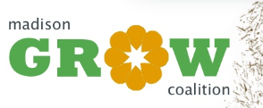
Introduction
  Nicole Nelson
  nnelson@sf.edu
  Assistant Professor of Biology
  University of Saint Francis
Notes:
19 years in Science Education
Undergrad Teaching Assistant - IU Biology
MS Science & HS Biology
Teaching Assistant – UW Biology
GROW Facilitator
Curriculum Writing – UW Arboretum
Assistant Professor of Biology – USF
EdD student – IU Bloomington

Slide 3
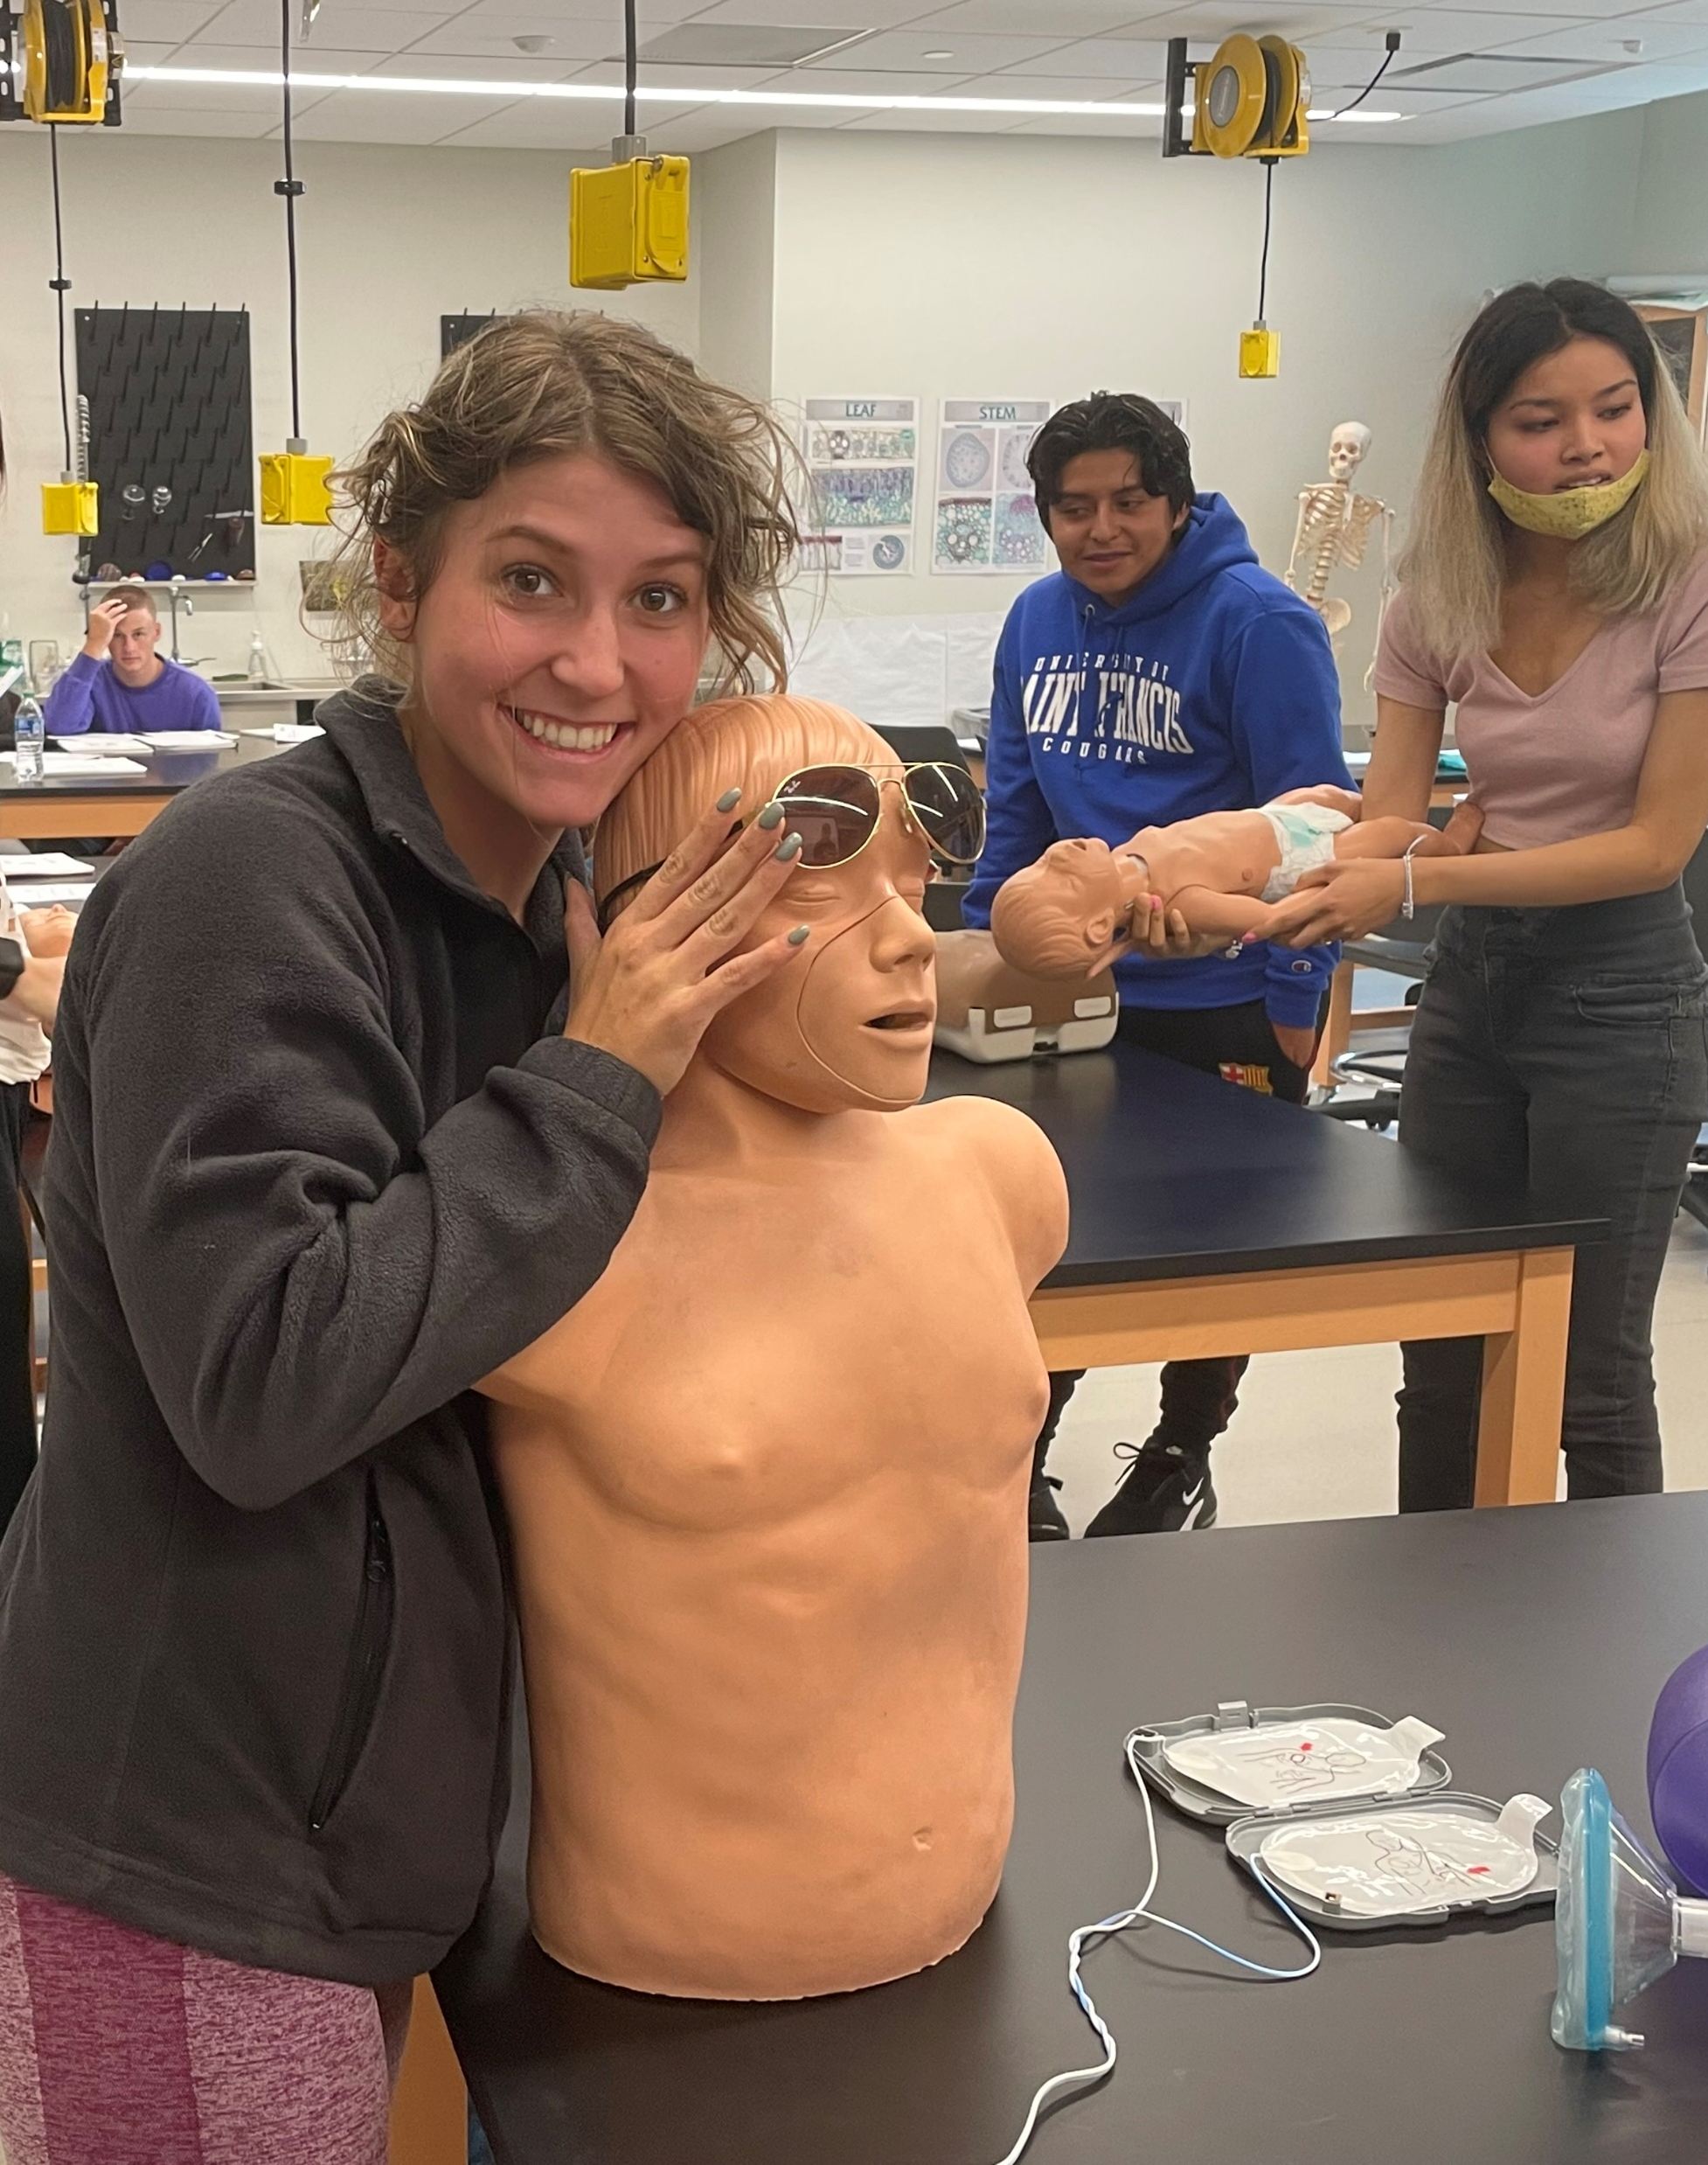
Foundations of Biology – “Gateway” Course
Biology
Biology pre-medicine
Biology pre-veterinarian
Biology pre-dental
Chemistry
Environmental Science
Handful of:
  Pre-PT, non-majors
Notes:
One of the courses I teach at USF is Foundations of Biology – Ecology, Evolution, Diversity
At USF – all science majors take the First Year Biology sequence BIOL 130 & BIOL 131

Slide 4
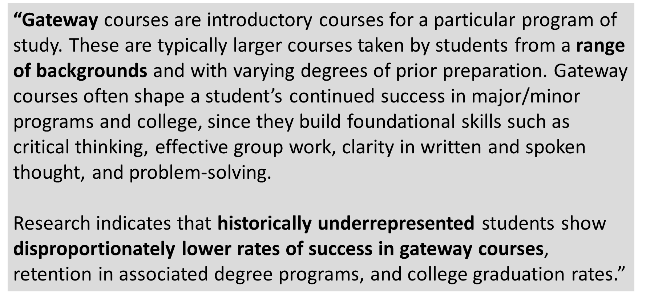

Notes:
As instructors, we are acting as the first “gate-keepers” for these students.

Slide 5
Any Gateway Course instructors?
What is your teaching philosophy for a Gateway Course?
Weed-out course?
Expect high attrition?
Make it easier to increase retention?
How do you manage the range of ability and college readiness levels?
Notes:
Think-pair-share?
Share out.
Does your teaching philosophy differ from your department’s or institution’s philosophy for that course?

Slide 6
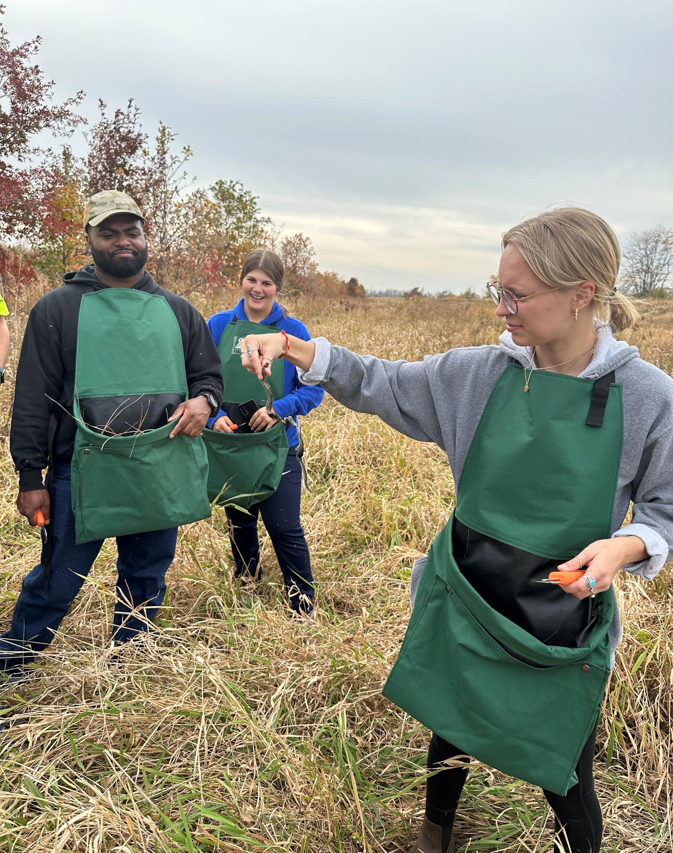
My concerns in BIOL 130
Attrition rate
Attendance
College-readiness
Study skills
Achievement gap
Notes:
FG/CG
URM/average

Slide 7
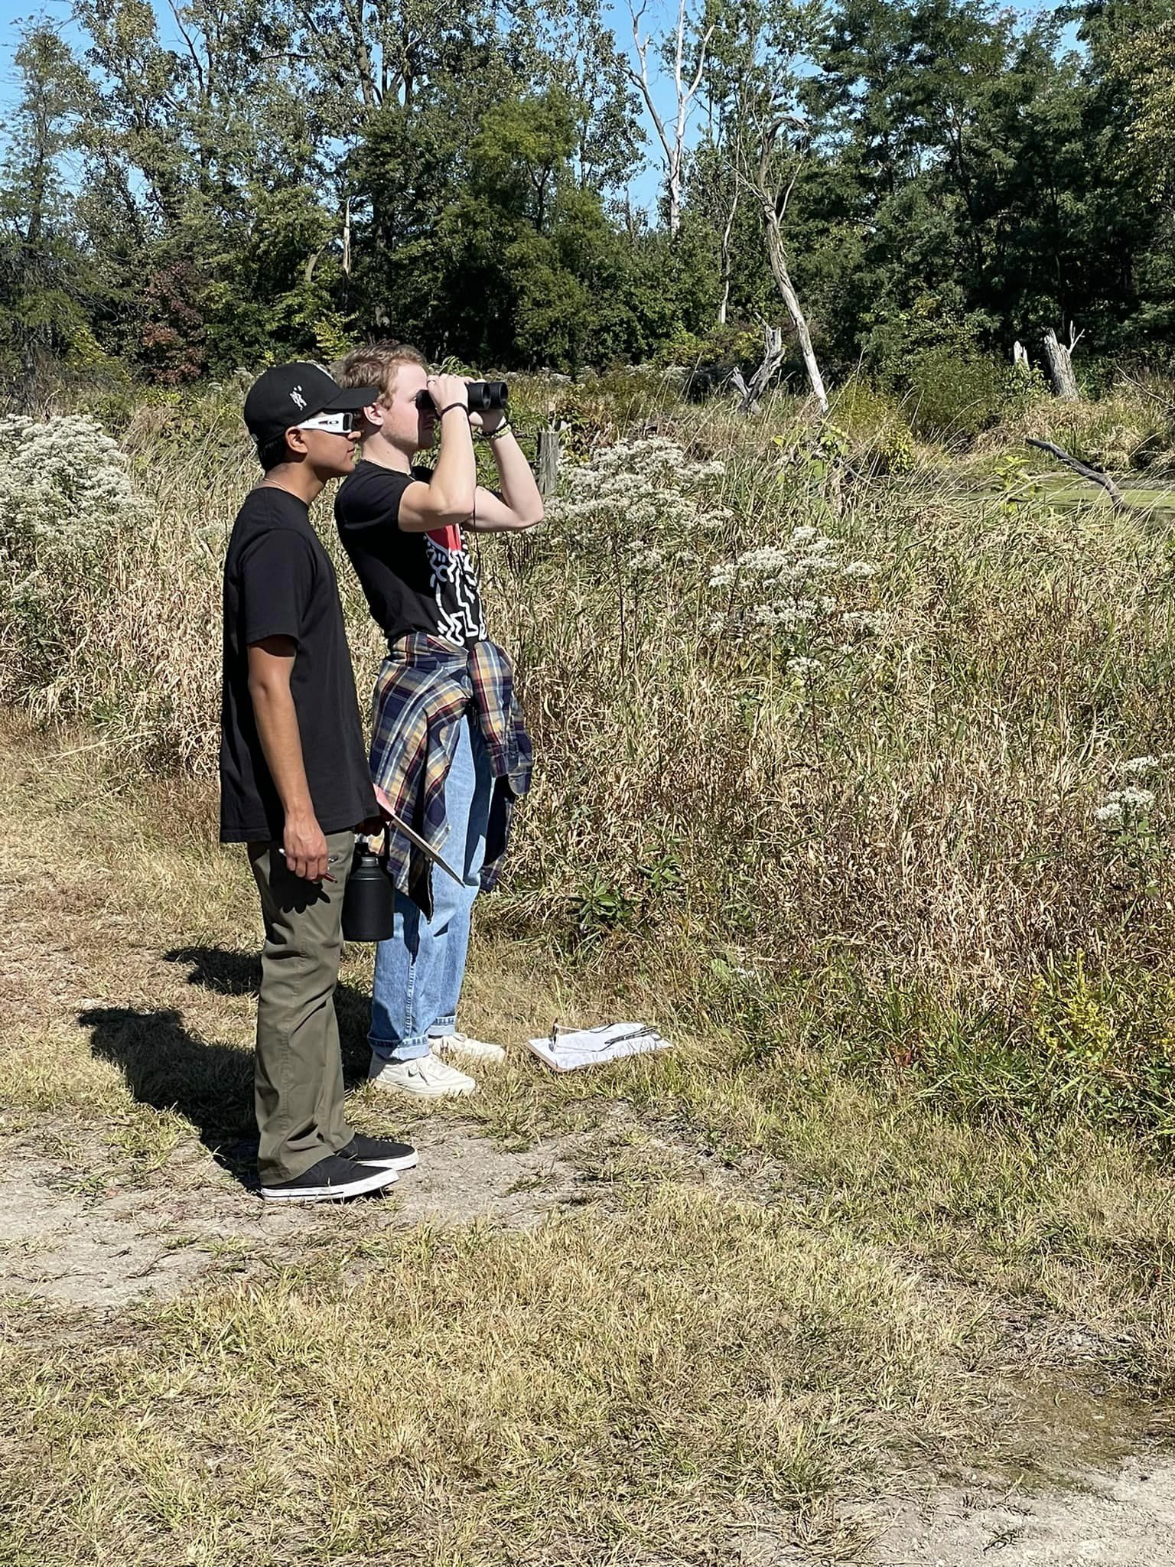
Reframing my philosophy
Demographic Shift at USF
  Fall 2022
    31% FG
    34% URM
Decrease in enrollment => need to retain the students we have!
1st year students are adjusting to college
Notes:
Non-selective admission
Need scaffolding and support
Don’t need to destroy dreams during 1st semester
Parenting teens has made me more empathetic to the developmental stage 18-19 yr olds are in, even though they look like adults

Slide 8
What are the causes of attrition?
Tinto’s Model of Student Departure (1993)
  Academic difficulties
  Inability of student to resolve educational and occupational goals
  Failure to become integrated – socially & academically
Yet, Kember et al. (2021) argues that Tinto’s model is outdated.
Notes:
Yet, Kember et al. (2021) argue that Tinto’s model was based on a time when the incoming college student population significantly differed from today. Historically, first-year college students were from families with above-average incomes and whose parents had also attended college, but today’s college students come from increasingly diverse backgrounds (Kember, 2021).

Slide 9
Attrition rates – FG & URM students
Nationally:
FG students’ attrition rate is 23.5% > average
Black students’ attrition rate is 33.8% > average
The Education Data Initiative (Hanson, 2022)

Slide 10
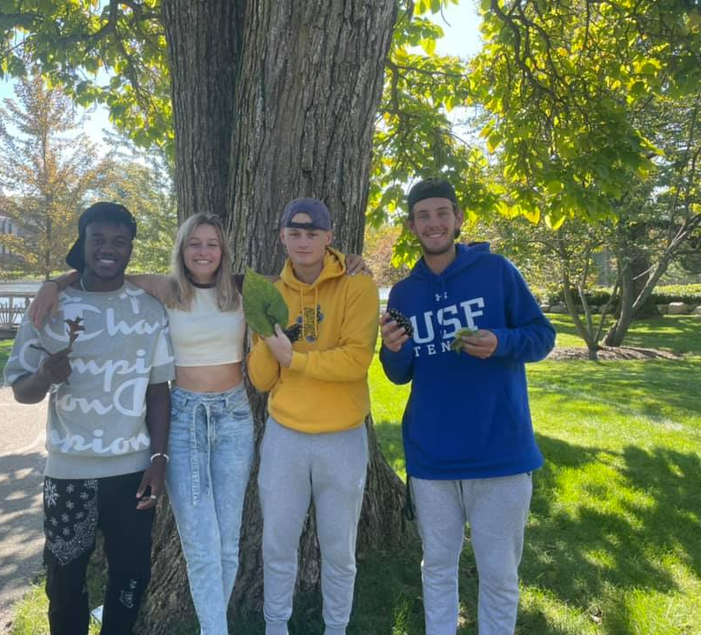
FG and URM – Factors that Lead to Retention
Institutional
Sociocultural
Instructional
*See annotated bibliography for citations
Notes:
Literature Review of 20 recent studies
Share annotated bibliography
Institutionally
Social capital
Campus engagement
Faculty/student interactions
Sociocultural
Imposter syndrome
Cultural mismatches (communal vs. competitive learning)
Stereotype Threat
Instructional
High-quality teaching, active learning, increased structure, student-centered
**Only one I have control over!

Slide 11
Fall 2023 Study
Measured Constructs:
Formal academic integration
Informal academic integration
Formal social integration
Informal social integration
Motivation for active learning
Financial pressure
Academic environment
Support from faculty
Goal commitment degree completion
Intent to Dropout
Action Research Study – Quantitative & Qualitative Data
n = 42
51 Likert-Scale Questions & 3 Open Response Questions
  Xu, Y. J. (2015). Attention to Retention: Exploring and Addressing the Needs of College Students in STEM Majors. Journal of Education and Training Studies, 4(2).
Compared FG and CG populations

Slide 12
Results - Comparison of CG and FG populations
Results of Mann-Whitney U Test for Corresponding Measured Constructs
 | CG |  | FG
 | Mean | SE | Mean | SE | p-value
Formal academic integration | 4.828 | 0.087 | 4.000 | 0.348 | 0.0091*
Informal social integration | 3.391 | 0.094 | 3.792 | 0.094 | 0.0418*
Financial pressure | 2.198 | 0.121 | 2.917 | 0.173 | 0.0003*
Intent to Dropout | 1.816 | 0.121 | 2.278 | 0.217 | 0.0315*
*Indicates p < 0.05

Slide 13
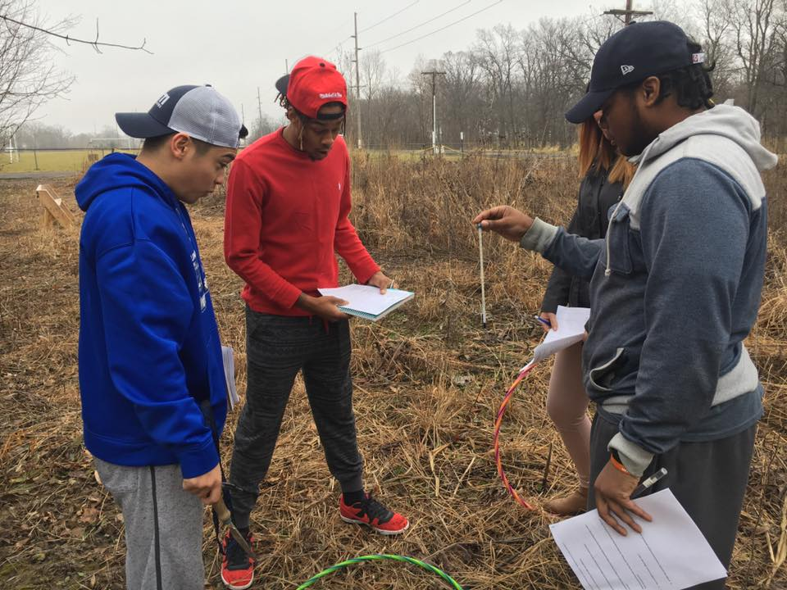
Results – Factors that Contribute to Student Retention
Students desire caring and supportive faculty, who are dedicated to interacting with students through coursework, advising, and research.
Students appreciate faculty who are experts in their field and make coursework engaging.
Institutionally, students desire a welcoming environment that provides opportunities for social interaction and bonding with peers.
The cost of college, including the availability of scholarships and financial aid, is a concern for students.
Students want to feel a sense of community within their academic program through small class sizes, study groups, and friendships.
Notes:
Qualitative Results – Thematic Analysis

Slide 14
BIOL 130 Instructional changes
Swapped first-year biology course sequence
  Departmental support
Increased course structure
  Weekly homework – open response
  In-class Quizizz games → review, practice with exam questions
    Collaborative, work with partners, change partners each week
  Submit Exam questions – discussion forum to share questions
    Student-led study questions

Slide 15
Preliminary Results
N=~45 students | Fall 2022 | Fall 2023
Exam 1 | 70% | 82%
Exam 2 | 78% | 84%
Exam 3 | 69% | 77%
Final Exam (Cumulative) | 71% | 77%
I’m left with more questions:
Was this a blip or is this replicable? – need more data.
Is my Pedagogical Content Knowledge increasing?
Close Achievement Gap?
Translating into increased retention
  1st & 2nd Semester?
  1st & 2nd Year?
Notes:
Are we just getting out of “Covid-kids”?
Was this group just stronger academically?
Am I getting better at teaching the material?

Slide 16
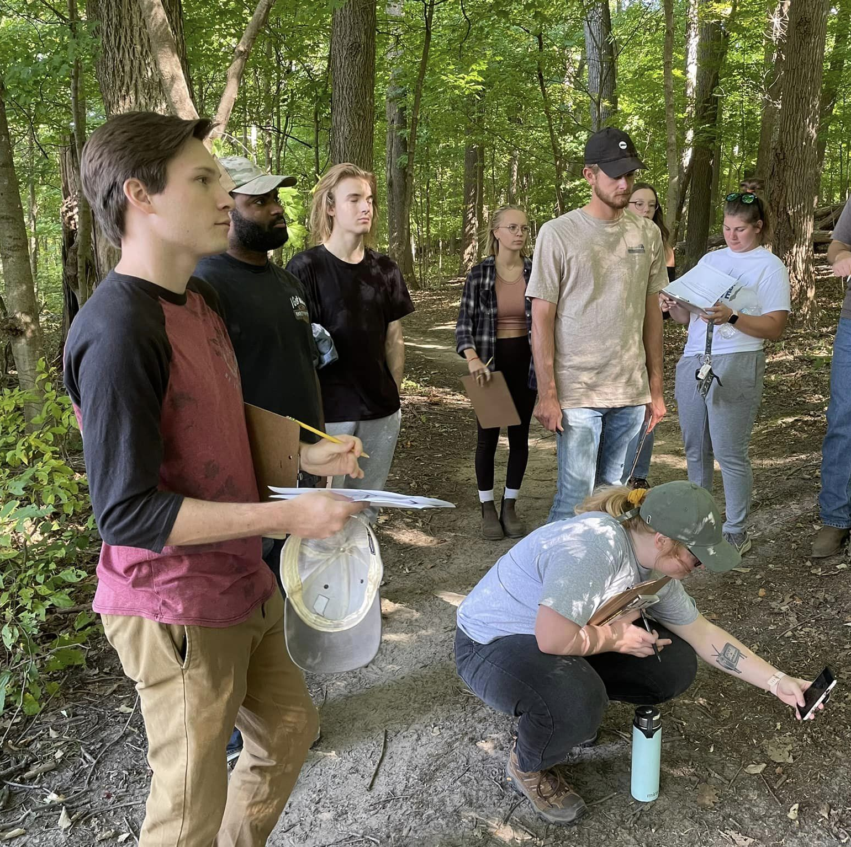
Discussion
Changes you’ve made to improve retention?
Something new you’d like to try?
Barriers to making instructional changes?
Notes:
Work with a neighbor to discuss these questions.
Write on post-it notes.
Add post-it notes to poster boards.
Full room discussion.

Slide 17
References
Hanson, M. (2022, June 17). College Dropout Rate [2020]: by Year + Demographics. EducationData. https://educationdata.org/college-dropout-rates
Kember, D., Leung, D., & Prosser, M. (2019). Has the open door become a revolving door? The impact on attrition of moving from elite to mass higher education. Studies in Higher Education, 46(2), 1–12. https://doi.org/10.1080/03075079.2019.1629411
Tinto, V. (1993). Leaving college : rethinking the causes and cures of student attrition. University Of Chicago Press.
Xu, Y. J. (2015). Attention to Retention: Exploring and Addressing the Needs of College Students in STEM Majors. Journal of Education and Training Studies, 4(2). https://doi.org/10.11114/jets.v4i2.1147
**Please Email me if you would like a copy of my full annotated bibliography of 20 peer-reviewed articles. nnelson@sf.edu

